Slide 1
Buffer Manager

Slide 2
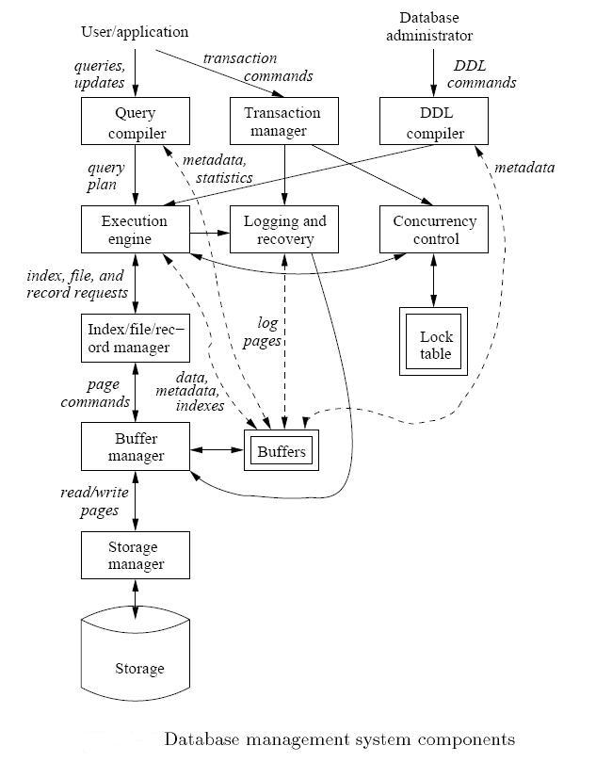
Covered in week 1

Slide 3
Buffer Manager
DB Higher-Level Components (E.g., Query Execution)
Higher-level components interact with Buffer Manager
Buffer Manager manages what blocks should be in memory and for how long
Any processing requires the data to be in main memory
Main memory
Buffer Manager
Storage Manager
Disk

Slide 4
Buffer Management in a DBMS
Page Requests from Higher Levels
BUFFER POOL
disk page
free frame
MAIN MEMORY
DISK
choice of frame dictated
by replacement policy
DB
1 2 3 4 5 6 7 8 9 10 11 12 13 14 15 16 … 999
Buffer Pool information table contains: <frame#, disk-pageid, pin_count, dirty>

Slide 5

Some Terminology
Array called “Buffer Pool”
Each entry is called “Frame”
Main Memory
Empty frame
Each entry in the Buffer Pool (Frame) can hold 1 disk block
A disk block in memory is usually called “memory page”
Buffer Manager Keeps track of:
  Which frames are empty
  Which disk page exists in which frame
Used frame (has a page)
Disk
Disk block
(Disk page)
Meta Data Information: <frame#, disk-pageid, pin_count, dirty>

Slide 6
Questions
Main Memory
How to efficiently find an empty frame?
Given a request for Block B1, how to efficiently find whether it exists of not? In which frame?
Empty frame
Used frame (has a page)
Naïve Solution
Scan the array with each request ➔ O(n)

Slide 7
Questions
Main Memory
How to efficiently find an empty frame?
Given a request for Block B1, how to efficiently find whether is exists of not? In which frame?
Empty frame
Used frame (has a page)
Better Solution (For Q1)
Keep a list of the empty frame# {1, 30, 50, …}
Better Solution (For Q1)
Keep a bitmap of the array size 111101001001…
0: Empty & 1: Used

Slide 8
Questions
Main Memory
How to efficiently find an empty frame?
Given a request for Block B1, how to efficiently find whether is exists of not? In which frame?
Empty frame
Used frame (has a page)
Keep a hash table, given block Id (e.g., B1) ➔ Returns the frame # (if exists)
Better Solution (For Q2)

Slide 9

Requesting A Disk Page
I need page 3
Higher level DBMS
component
Buf Mgr
BUFFER POOL
MAIN MEMORY
22
disk page
3
I need page 3
3
free frames
Disk Mgr
DISK
1
2
3
…
22
…
90
If requests can be predicted (e.g., sequential scans) pages can be pre-fetched several pages at a time!

Slide 10
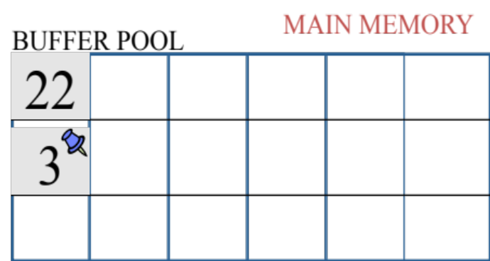
Pin A Memory Page
Pin this page
Can be a flag (T & F)
Can be a counter (0 = unpinned)
Pinning a page means not to take from the memory until un-pinned
Why to pin a page
  Keep it until the transaction completes
  Page is important (referenced a lot)
  Recovery & Concurrency control (they enforce certain order)
  Swizzling pointers refer to it

Slide 11
Releasing Unmodified Page
I read page 3 and I’m done with it
Higher level DBMS
component
Buf Mgr
BUFFER POOL
MAIN MEMORY
22
disk page
3
free frames
Unpin the page (if you can)
since page is not modified ➔ Just claim this frame# in free list
No need to write back to disk

Slide 12
Releasing Modified page
I wrote on page 3 and I’m done with it
Higher level DBMS
component
MAIN MEMORY
Buf Mgr
BUFFER POOL
22
disk page
3’
3’
free frames
Disk Mgr
DISK
1
2
3’
3
…
22
…
90

Slide 13
More on Buffer Management
Meta Data Information: <frame#, disk-pageid, pin_count, dirty>
Requestor of page must eventually unpin it, and indicate whether page has been modified:
  dirty bit is used for this.
Page in pool may be requested many times,
  a pin count is used.
  To pin a page, pin_count++
  A page is a candidate for replacement iff pin count == 0 (“unpinned”)
CC & recovery may entail additional I/O when a frame is chosen for replacement.
  Write-Ahead Log protocol; more later!

Slide 14
What if the buffer pool is full? ...
If requested page is not in pool:
  Choose a frame for replacement.
    Only “un-pinned” pages are candidates!
  If frame is “dirty”, write it to disk
  Read requested page into chosen frame
Pin the page and return its address.

Slide 15
Buffer Replacement Policy
Frame is chosen for replacement by a replacement policy:
  Least-recently-used (LRU)
  First-in-First-Out (FIFO),
  Clock Policy
Policy can have big impact on # of I/O’s; depends on the access pattern.
May need additional metadata to be maintained by Buffer Manager

Slide 16
LRU Replacement Policy
Least Recently Used (LRU)
  for each page in buffer pool, keep track of time when last accessed
  replace the frame which has the oldest (earliest) time
  very common policy: intuitive and simple
    Works well for repeated accesses to popular pages
Problems: Sequential flooding
  LRU + repeated sequential scans.
  # buffer frames < # pages in file means each page request causes an I/O.
  Expensive ➔ Each access modifies the metadata

Slide 17
LRU causes sequential flooding in a sequential scan
I need page 1
I need page 2
I need page 3
I need page 4
Higher level DBMS
component
I need page 1
I need page 2…ARG!!!
Buf Mgr
BUFFER POOL
1
4
2
1
3
Disk Mgr
MAIN MEMORY
DISK
1
2
3
4

Slide 18
“Clock” Replacement Policy
Frame 1
An approximation of LRU
Each frame has
  Pin count ➔ If larger than 0, do not touch it
  Second chance bit (Ref) ➔ 0 or 1
Imagine frames organized into a cycle.
A pointer rotates to find a candidate frame to free
Frame 4
Frame 2
Frame 3
IF pin-count > 0 Then ➔ Skip
IF (pin-count = 0) & (Ref = 1) ➔ Set (Ref = 0) and skip ( second chance)
IF (pin-count = 0) & (Ref = 0) ➔ free and re-use

Slide 19
“Clock” Replacement Policy
Frame 1
Higher level DBMS
component
I need page 5
I need page 6
Frame 4
Frame 2
Frame 3
Ref = 1
Buf Mgr
1
5
2
6
3
4
do for each page in cycle {
if (pincount == 0 && ref bit is on)
turn off ref bit;
else if (pincount == 0 && ref bit is off)
choose this page for replacement;
} until a page is chosen;
1
2
3
4
5
6

Slide 20
Back to The Bigger Picture

Slide 21
Relation➔ File ➔ Blocks
Select ID, name, address
From R
Where …
Each relation, e.g., R, has a corresponding heap file storing its data
Catalog tables in DBMS store metadata information about each heap file
  Its block Ids, how many blocks, free spaces

Slide 22
Heap File Using a Page Directory
Data
Page 1
Header
Page
Data
Page 2
Data
Page N
DIRECTORY
The metadata info ➔ directory
Each entry in this directory points to a disk page. It contains
  Block Id, how many records this block hold
  Whether it has free space or not
  Whether the free space is contiguous or not
  …

